Slide 1
Main Chat Screen
USER
CHAT TEXT
BOT
CHAT TEXT
USER
CHAT TEXT
CHAT FLOW
BOT
CHAT TEXT
USER
CHAT TEXT
MESSAGE
SEND

Slide 2
USER TYPES SPECIFIC TEXT (1)
USER
CHAT TEXT
BOT
CHAT TEXT
USER
Google Search: Cake Recipies
CHAT FLOW
BOT
Searching
MESSAGE
SEND

Slide 3
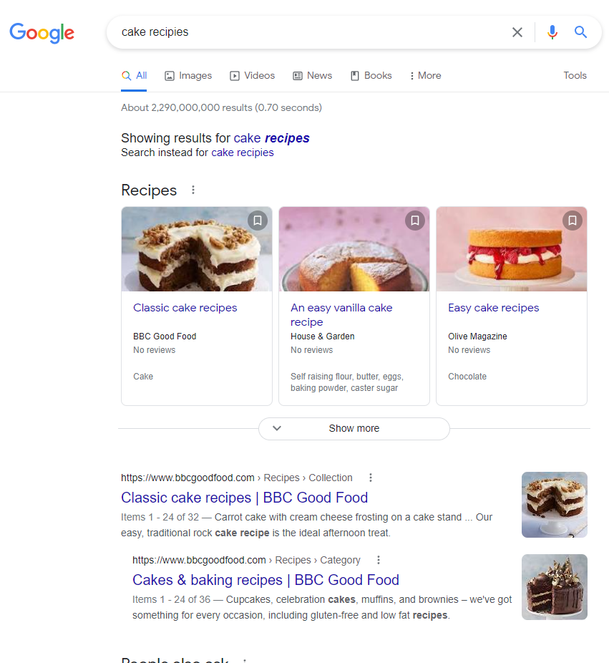
USER TYPES SPECIFIC TEXT (2)
Simple Google Search
MESSAGE
SEND

Slide 4
USER TYPES SPECIFIC TEXT (3)
USER
CHAT TEXT
BOT
CHAT TEXT
USER
Go to Location: Kilkenny
Simple Google Map Search
BOT
Searching
MESSAGE
SEND

Slide 5
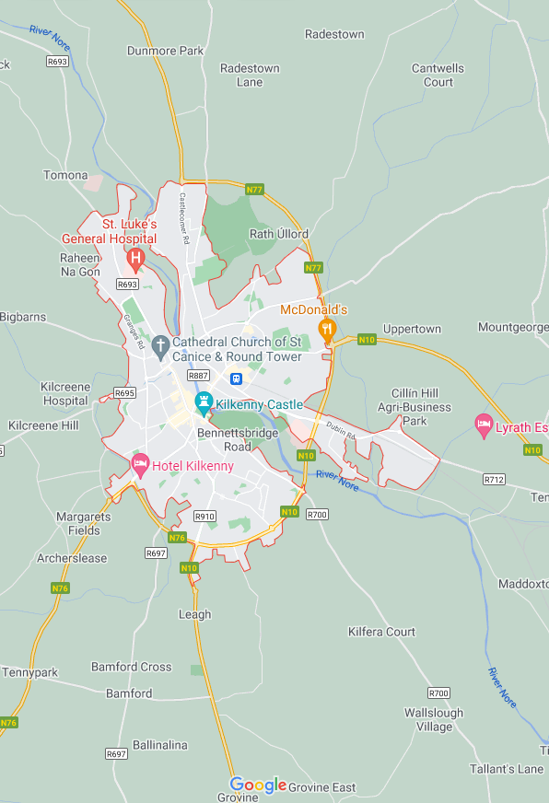
USER TYPES SPECIFIC TEXT (4)
Simple Google Map Search
MESSAGE
SEND

